Slide 1
Multivariate Prediction
William Holbrook
PSYC 60; Professor Chang; May 23, 2024

Slide 2
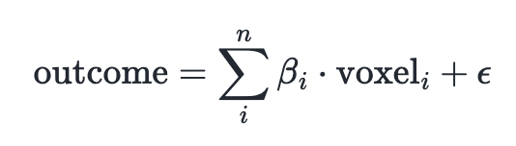
Overview
GLM used to predict voxel activation (single subject and group level)
Multivariate prediction uses voxels to predict outcome
Classification: Different conditions, i.e. happy or sad
Prediction: Magnitude of response
Voxel confidence (how certain) vs. voxel weight (how much)

Slide 3
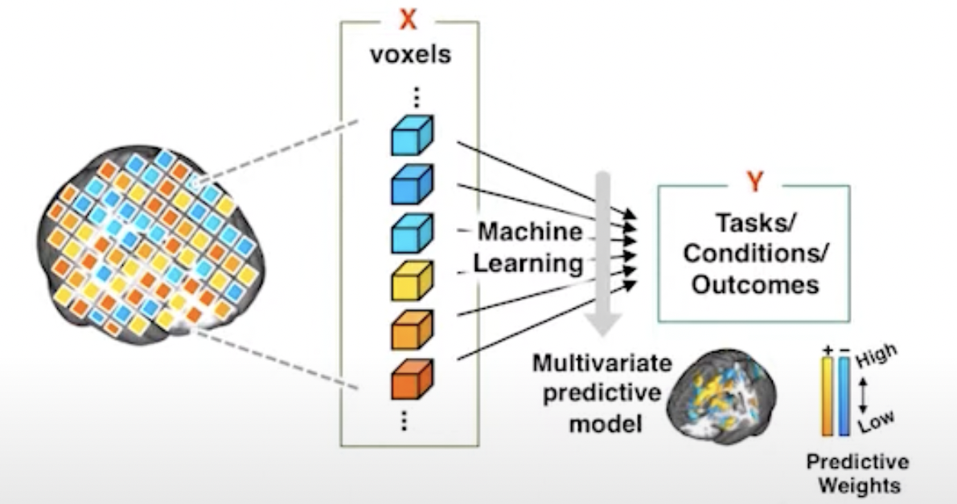
Steps
Feature Selection – Whole Brain or Regions
Model Training – Machine learning
Cross-validation - Training and testing divide
Model Interpretation - Experimental results

Slide 4
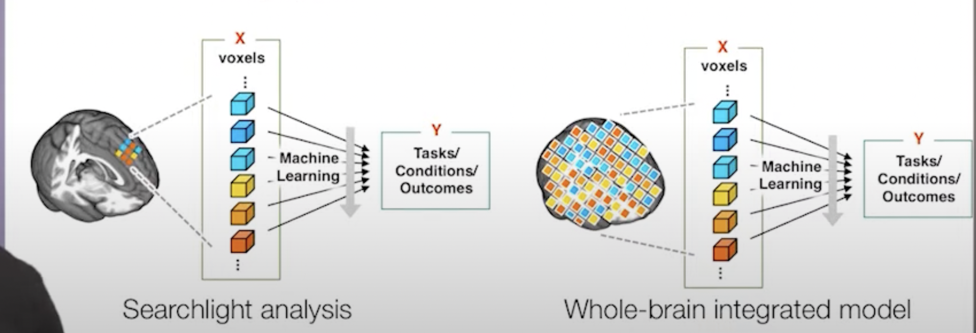
Feature Selection
Local/Searchlight
Structural mask (similar to connectivity analysis)
Whole-brain/Integrated
All voxels
Combined with structural or multimodal data

Slide 5
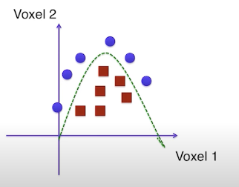
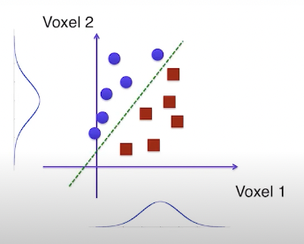
Model Training
Linear: Y = mx + b
x - Features (Voxels)
Y - Labels (Prediction)
m - Weights (Learn)
b - Intercept (Learn)
Support Vector Machine (SVM):
Able to fit non-linear data
Maximizes margin

Slide 6
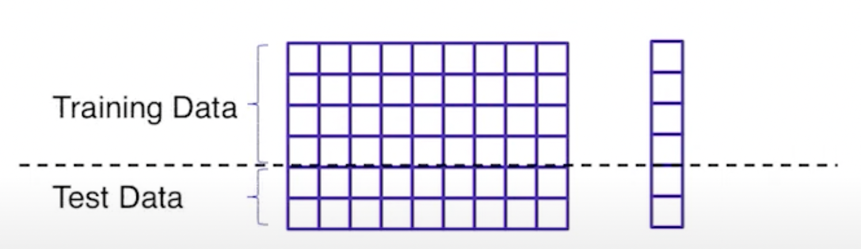
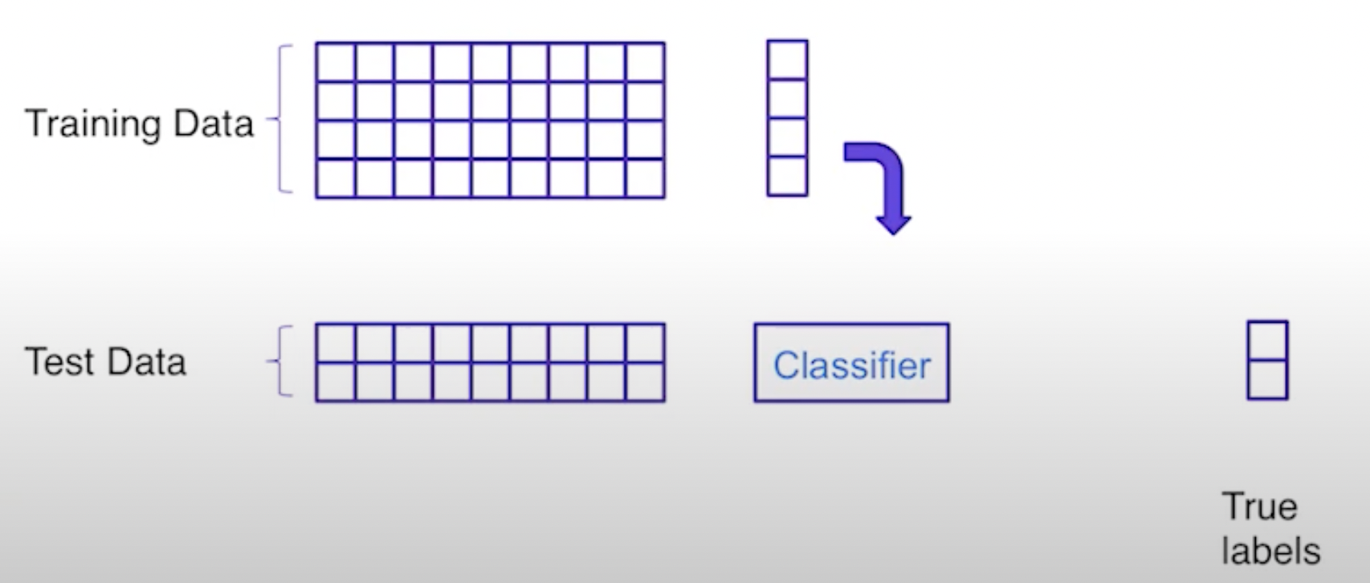
Cross-Validation
Generalizability
Model performs better on training data
Overfitting
Penalty for too many regressors

Slide 7
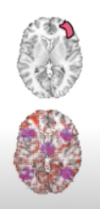
Model Interpretation
Localized or generalized function
Percent of variance explained
Reaction to novel stimuli

Slide 8
References
https://dartbrains.org/content/Multivariate_Prediction.html

